Slide 1

Markov Chain monte carlo
Joelle Strom
Consulting Presentation #2
Nov. 22, 2021

Slide 2
Outline
Why use it?
01
What is it?
02
How does it work?
03

Slide 3
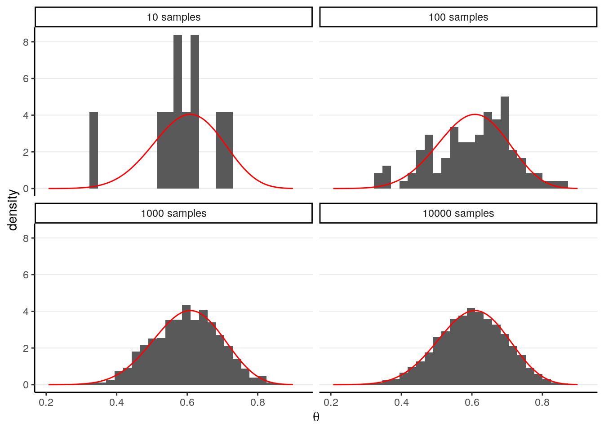
Inference and Simulation
When we want to calculate a quantity from a probabilistic model, we are conducting inference
Monte Carlo sampling is used for distributions where the direct calculation is too difficult to solve
“For most probabilistic models of practical interest, exact inference is intractable, and so we have to resort to some form of approximation.”
-Pattern Recognition and Machine Learning, 2006 (p. 523)
Notes:
Examles of inference are calculating an expected probability or estimating density; direct calculation is often an integral, and distributions can involve many random variables that complicate the calculation; often a problem especially in Bayesian inference where we must integrate over the priors; in Monte Carlo simulation, we take many independent samples from the distribution and use those samples to make inference; similar to bootstrap! But bootstrap is based on sampling from a data set, whereas this is sampling from a population

Slide 4
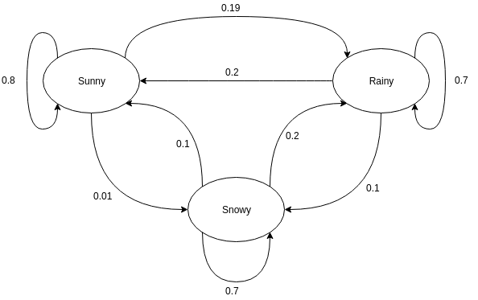
A Step Further
So then why do we need another method?
Monte Carlo does NOT work in high dimensions
Monte Carlo also assumes that each sample is independent, which is not always the case
Markov Chain Monte Carlo (MCMC) is the solution to this problem!
Combines elements of Markov Chain with the Monte Carlo sampling method
Was originally developed in the 1940s and initially used in particle physics research
Markov chains are sequences that satisfy the Markov Property: the probability of the next state depends upon the present state
Notes:
Assumption of independence is violated most often in Bayesian inference, with structured or graphical probabilistic models

Slide 5
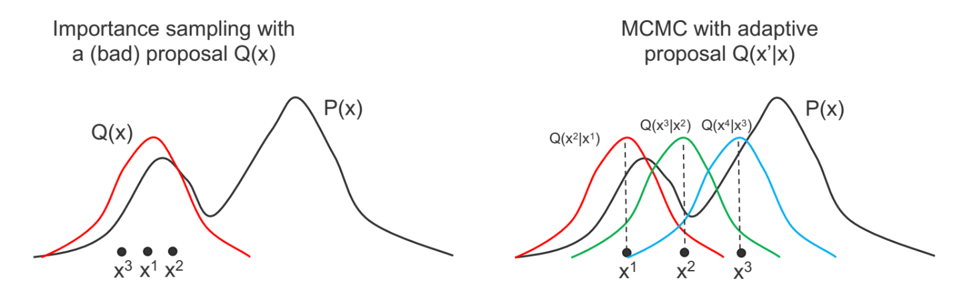
Putting It All Together
MCMC combines Markov Chain and Monte Carlo
Random samples are taken from the population, just as in Monte Carlo
BUT now each sample is probabilistically dependent on the previous sample
Notes:
The idea is that the estimation chain converges to the true distribution; still follow the Monte Carlo process where samples are combined

Slide 6
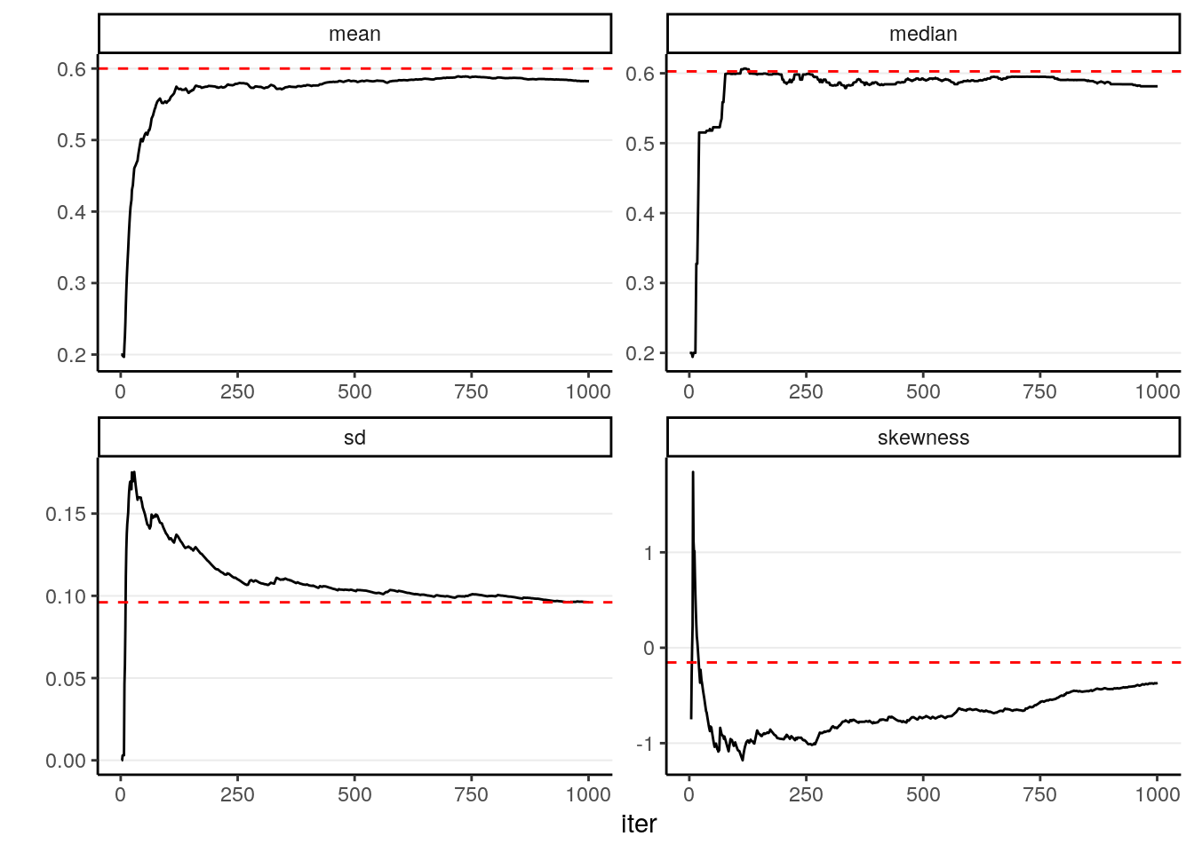

The Algorithm(s)
Metropolis algorithm
Choose some value within the sample space (x₀) and choose a symmetric distribution
Generate a random value (x_{prop}) from the distribution based around the original value
Calculate density ratio $\frac{P(X=x_{prop}|y)}{P(X=x_{0}|y)}$
Based on a set of criteria, either accept x_{prop} or x₀ into the sample and retain as new starting value
Repeat steps 1-4
The Metropolis-Hastings algorithm is modified to allow the use of asymmetric distributions
The Gibbs sampler is a more generalized version for multiparameter problems
Other algorithms include Hamiltonian Monte Carlo or No-U-Turn sampler

Slide 7
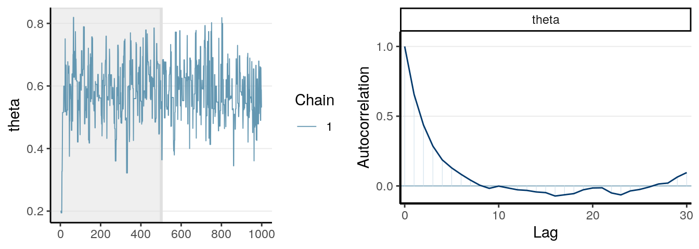
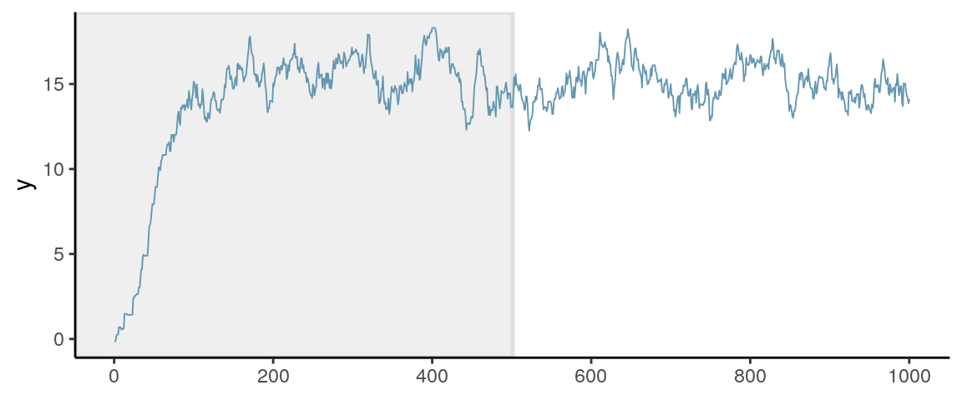
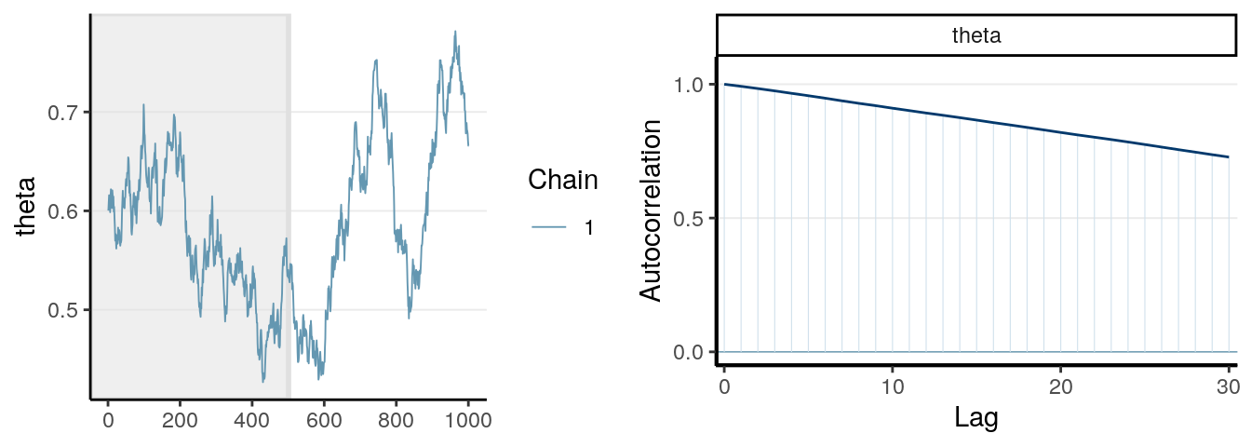
Limitations of MCMC
Trace plot
Burn-in/Warmup
Effective sample size
Notes:
There might be a “burn-in” phase at the beginning of MCMC where the chain is wildly off before it finds a useful search, these early samples can be discarded; hard to know when enough samples have been taken, often run a set (large, like 10,000 large) number of times, effective sample size is smaller than the number of runs; trace plot should look like the top panel, where the proposed value covers the parameter space quickly and doesn’t get stuck, choice of sigma for normal distribution can affect the trace

Slide 8
References
Bishop, C.M. Pattern Recognition and Machine Learning. (2006). Retrieved November 9, 2021, from https://link.springer.com/book/9780387310732
Brooks, S., Gelman, A., Jones, G., & Meng, X.-L. (2011). Handbook of Markov Chain Monte Carlo. CRC Press.
Brownlee, J. (2019, November 5). A Gentle Introduction to Markov Chain Monte Carlo for Probability. Machine Learning Mastery. https://machinelearningmastery.com/markov-chain-monte-carlo-for-probability/
Chen, Y.-C. (n.d.). Monte Carlo Simulations and Bootstrap. 13.
Lai, M. (n.d.). Chapter 6 Markov Chain Monte Carlo | Course Handouts for Bayesian Data Analysis Class. Retrieved November 9, 2021, from https://bookdown.org/marklhc/notes_bookdown/markov-chain-monte-carlo.html#the-metropolis-hastings-algorithm
Molina, A. (2018, November 26). Markov Chains with Python. Medium. https://medium.com/@__amol__/markov-chains-with-python-1109663f3678
Robert, C., & Casella, G. (2011). A Short History of Markov Chain Monte Carlo: Subjective Recollections from Incomplete Data. Statistical Science, 26(1). https://doi.org/10.1214/10-STS351

